Slide 1
STOCK PREDICTION USING LARGE TWITTER DATA
Team 4: Zeal Patel
Sahaja Adevalli
Sreevalli Tata

Slide 2
Objective:
The objective of the project is to use various techniques of machine learning which will give more accurate, precise and simple ways to find variations and issues related to stock prices and the market prices. Also, we will be using large Twitter data to do sentimental analysis because it can reflect public thought at some extend.

Slide 3
Extraction of Large set of Twitter data from Twitter API
Training the data set (Machine Learning)
Website
Step 1
Step 2
Step 3
Step 4
Step 5
Working on sentimental analysis using polarity value and displaying the info in wordcloud
Training the data set (Deep Learning)

Slide 4
Implementation Techniques and Tools
Machine learning libraries are used for the development and experiment of the project. Tools such as Anaconda Python, Jupyter Notebook and Google Colaboratory will be utilized for this process.
We are using Supervised learning for this project because we training our model based on previous outcomes. In our case we know all possible outcomes, this makes us go with Supervised learning. The problem that we are dealing with is a classification problem where we are trying to classify each stock whether it is going up or down based on tweets that we receive.

Slide 5
STEP 1: Extraction of Twitter data
In this step we have extracted the data from Twitter API by downloading tweets in JSON. The result you receive from the Twitter API is in a JSON format and we have converted it into csv format, and has quite an amount of information attached and we have created a dataframe for all those tweets. We are using Tweepy library as it is more efficient compared to others. Also, we have streamed the data and filtered it using stream. Also for training data we used GetOldTweets3 to download tweets from 2017.
Also, we have done preprocessing of data which is filtering of data if not there is a higher chance that you are working with noisy and inconsistent data. We have cleansed the data we have only included tweets with alphabets and neglected all others.

Slide 6
STEP 2: Sentimental Analysis
We have cleansed the data by only included tweets with alphabets and neglected all others.
Used TextBlob for finding polarity value. Polarity value less than zero is considered as negative and greater than zero is considered as positive.

Slide 7
STEP 3: Training the Data Set (ML)
Calculating the accuracy of the model using logistic regression.
Compare the accuracy of the trained model and already existing model.

Slide 8
STEP 4: Training the Data set (Deep Learning)
We have used the LSTM technique which helps in increasing the accuracy of data, by removing the unwanted data by setting the LAN rate (Lr). Long short-term memory (LSTM) is an artificial recurrent neural network (RNN) architecture used in the field of deep learning. Unlike standard feedforward neural networks, LSTM has feedback connections. We also perform back propogation by updating the weights and biases.Then we have trained the data and found the accuracy and compared it with the previous data set.

Slide 9
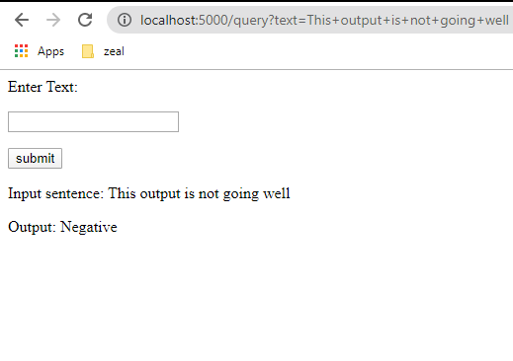
STEP 5: Website

Slide 10
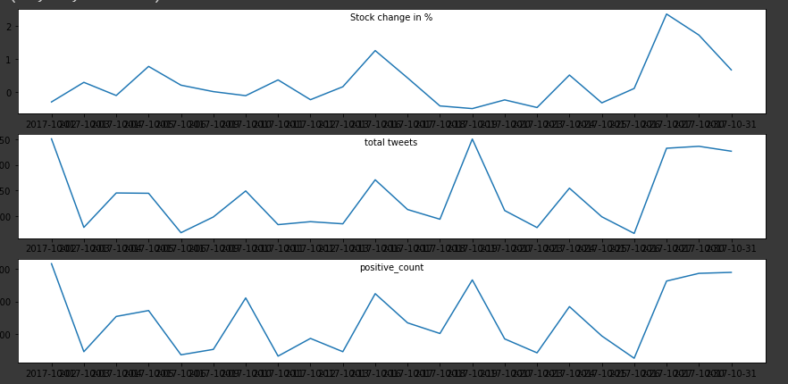
Some comparision in data set build

Slide 11
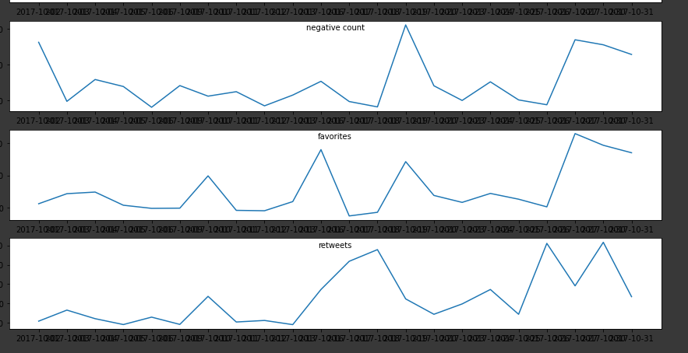
Some comparison in data set build

Slide 12
Challenges:
Faced difficulties in finding the datasets related to stocks.
We have thought of filter the data using emoticons which might give more accurate sentimental analysis but as we are not aware of the unique code used for it we haven’t chosen that step.
Merging data with stock market values like open, close, high, low.
Applying sentimental model to twitter text and building new data for another stock prediction application.

Slide 13


Slide 14


